Slide 1
Analysis of Smokers and Non-smokers Insurance Charges

Slide 2
Overview and problem statement
We are being told that insurance companies charge more for smokers, regardless of their wellness status.
Before digging into how much insurance companies charge more, is there a real difference in charges for smokers and non-smokers?
By how much on average?
Does ‘healthy’ smokers get away with higher charges?
Notes:
We are framing this problem in terms of a clear business need. And asking the question, what is this analysis actually going to do for our business, right? Remember, it’s our world, the statistics are just living in it!

Slide 3
Data analyzed
1338 records total
274 records for smokers; 1064 records for non-smokers
Data includes age, sex, bmi, children, smoker, region, and charges
Raw data available here
Notes:
Set the stage a bit -- where is the data coming from? Be as transparent as possible. Explain to the audience what you were thinking about data collection in terms of what data was necessary and how that in turn shaped your thinking on the kind of analysis that would be most appropriate given the objective.

Slide 4

Focus on smoker VS non-smoker
Notes:
Moving from research question to some kind of hypothesis -- you want to use logic, theory and prior empirical evidence to move toward some hypotheses you can test. This is why domain expertise cannot be overlooked among data scientists.

Slide 5
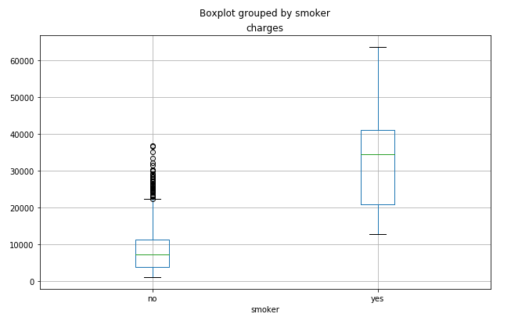
Statistically significant difference between Smokers and Non-smokers Insurance Charges :
With 95% confidence, the average charge for smokers is between $23,077 and $25,865 higher that for non-smokers
For the 274 smokers in our sample, this translates to a possible lift of between $23K and $26K per year.
Notes:
A statistical method is not a story, but we can tell a story from the statistics. For example, using confidence intervals we can put into dollars what we think would happen if we make some business move, given the data that we have.
The words “t-test,” “normality,” “independent samples” etc did not come up at all in this explanation! Although someone who does know about this stuff can still have confidence in the results with the way you have laid out the story and the quantifiable results.

Slide 6

Focus on the healthy smokers and non-smokers
Notes:
Moving from research question to some kind of hypothesis -- you want to use logic, theory and prior empirical evidence to move toward some hypotheses you can test. This is why domain expertise cannot be overlooked among data scientists.

Slide 7
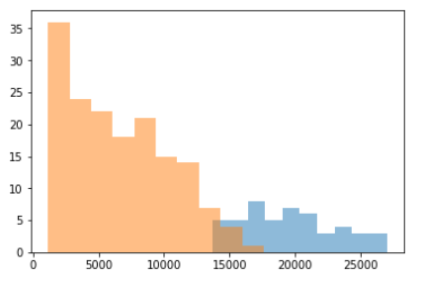
Statistically significant difference between Healthy Smokers and Non-smokers Insurance Charges
With 95% confidence, the average charge for healthy smokers is between $11,910 and $14,273 higher that for heathy non-smokers
For the 50 healthy smokers in our sample, this translates to a possible lift of between $11K and $14K per year.
Notes:
A statistical method is not a story, but we can tell a story from the statistics. For example, using confidence intervals we can put into dollars what we think would happen if we make some business move, given the data that we have.
The words “t-test,” “normality,” “independent samples” etc did not come up at all in this explanation! Although someone who does know about this stuff can still have confidence in the results with the way you have laid out the story and the quantifiable results.

Slide 8
Next Step
Consider other health factors besides BMI
Consider geographic factors such as regions
Consider physical factors such as pre-exiting conditions

Slide 9
With such a difference, make smart choice
Reaching out to general smokers that financially speaking, smoking is not a smart choice, even though they are considered as ‘healthy’.
A/B test differences on how age, region, and other physical factors may affect smokers’ insurance charges.
Notes:
https://unsplash.com/photos/OX_en7CXMj4
Then we want to move to recommendations, what is the call to action? What should your audience do now that they know what you have told them?

Slide 10
Questions?

Slide 11
Thank You

